Slide 1
Polariqon
Basic Presentation

Slide 2
genesis
We founded and ran Ultrasolar Technology for a decade, which signed an acquisition agreement with a New York based company 6 months ago.
  The technology used polaritons to increase the efficiency of solar cells
  Polaritons were converted to phase locked electromagnetic waves, which interacted with semiconductor band structure in solar cells
Polaritons and semiconductor band structure can also generate room temperature detectable quantum states / Qubits

Slide 3
Design
Polaritons have been used to act as qubits
  Allows superposition and entanglement.
Solar cell has been used as a quantum state detector for polariton-based qubits, reading out their state by detecting their photonic decay.

Slide 4
Polariton as building blocks
Communication
Polaritons enable entanglement distribution for quantum communication, with solar cells detecting the transferred quantum information.
Memory
Quantum memory could use polaritons to store quantum information, with solar cells reading out the stored states when necessary.

Slide 5
Polariqon qBits
Photons of Polariqon interact with the states in the valence band
Electrons in the valence band move to the top of the valence band

Slide 6
Design Block Diagram
Blackbody IR Radiation
Electro/ magnetic control for Quantum Gate
Done
Standing wave of IR in LN Film Crystal
IR Photons+ LN Polaritons
Phase locked Photon Radiation
Photoemission in solar cell absorber
Done
Done
Done- optimizing
Done-
Refine measurement

Slide 7
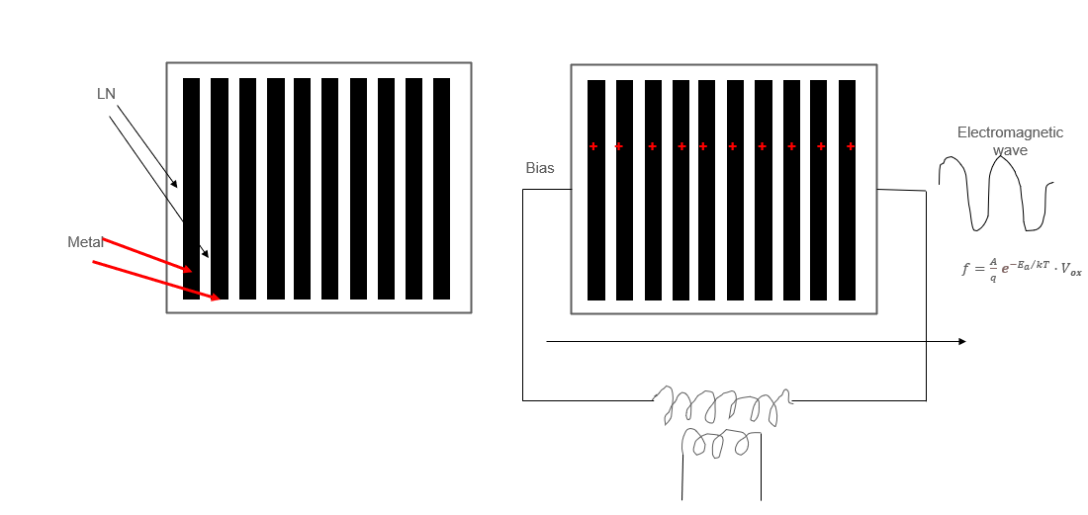
Polariton and Photon generation

Slide 8
pOLAriton measurement-1
IR Source
Filter Coherent Polariton
IR detector was used to measure the Qubits from this step
Measurement:
  αI1>+βI0> vales of α and β were detected at room temperature repeatedly
Detector
αI1>+βI0>

Slide 9
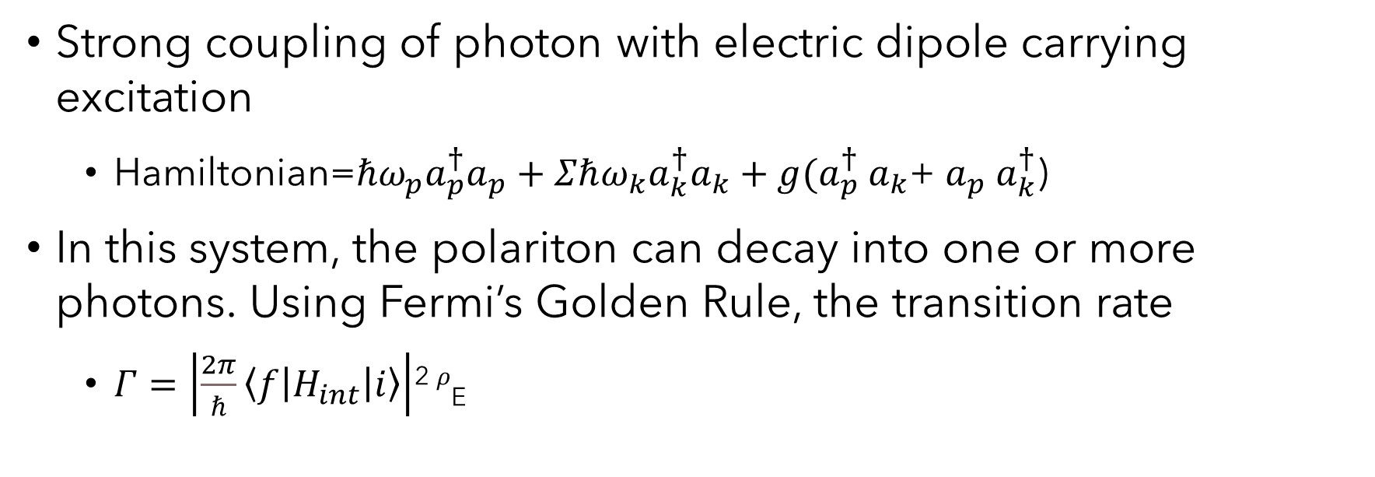
Polariton to photon
Strong coupling of photon with electric dipole carrying excitation
  Hamiltonian=$ℏω_{p}a_{p}^{†}a_{p}+Σℏω_{k}a_{k}^{†}a_{k}+g(a_{p}^{†}$ $a_{k}$+ $a_{p}$ $a_{k}^{†}$)
In this system, the polariton can decay into one or more photons. Using Fermi’s Golden Rule, the transition rate
  $Γ=\left|\frac{2π}{ℏ}\left\langle f | H_{int} | i\right\rangle \right|$² $ρ$_{E}

Slide 10
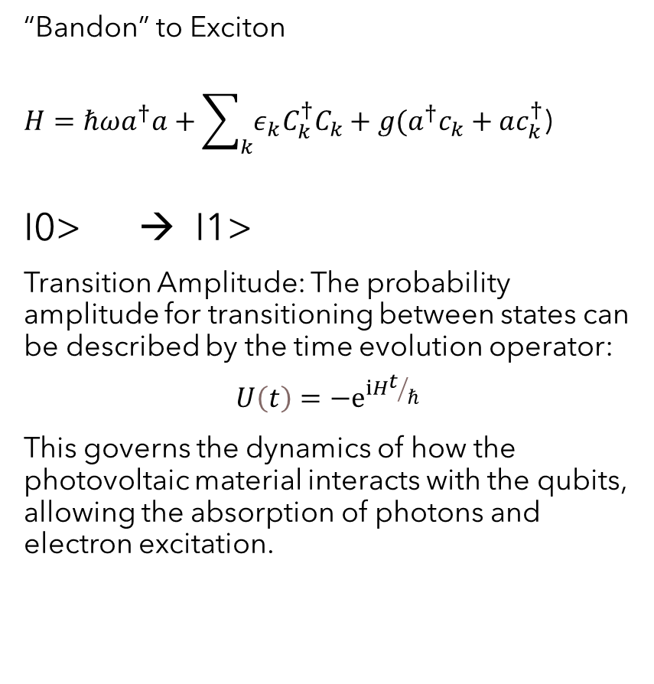
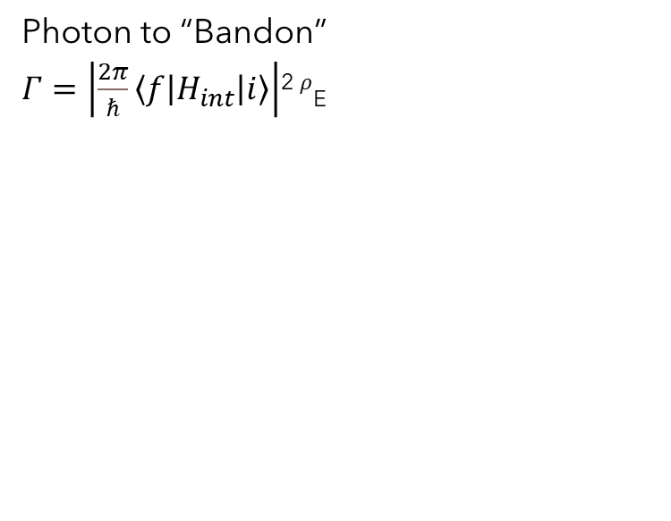
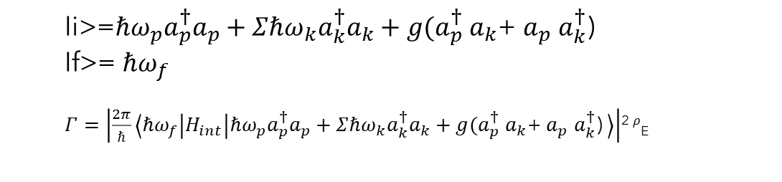
Photon to Exciton
“Bandon” to Exciton
$H=ℏωa^{†}a+\sum_{k}{ε_{k}C_{k}^{†}C_{k}}+g(a^{†}c_{k}+ac_{k}^{†}$)
I0> → I1>
Transition Amplitude: The probability amplitude for transitioning between states can be described by the time evolution operator:
$$U\left(t\right)=−ⅇ^{ⅈHt/ℏ}$$
This governs the dynamics of how the photovoltaic material interacts with the qubits, allowing the absorption of photons and electron excitation.
Photon to “Bandon”
$Γ=\left|\frac{2π}{ℏ}\left\langle f | H_{int} | i\right\rangle \right|$² $ρ$_{E}
  Ii>=$ℏω_{p}a_{p}^{†}a_{p}+Σℏω_{k}a_{k}^{†}a_{k}+g(a_{p}^{†}$ $a_{k}$+ $a_{p}$ $a_{k}^{†}$)
  If>= $ℏω_{f}$
  $Γ=\left|\frac{2π}{ℏ}\left\langle ℏω_{f} | H_{int} | ℏω_{p}a_{p}^{†}a_{p}+Σℏω_{k}a_{k}^{†}a_{k}+g(a_{p}^{†} a_{k}\text{+} a_{p} a_{k}^{†}\text{) }\right\rangle \right|$² $ρ$_{E}

Slide 11
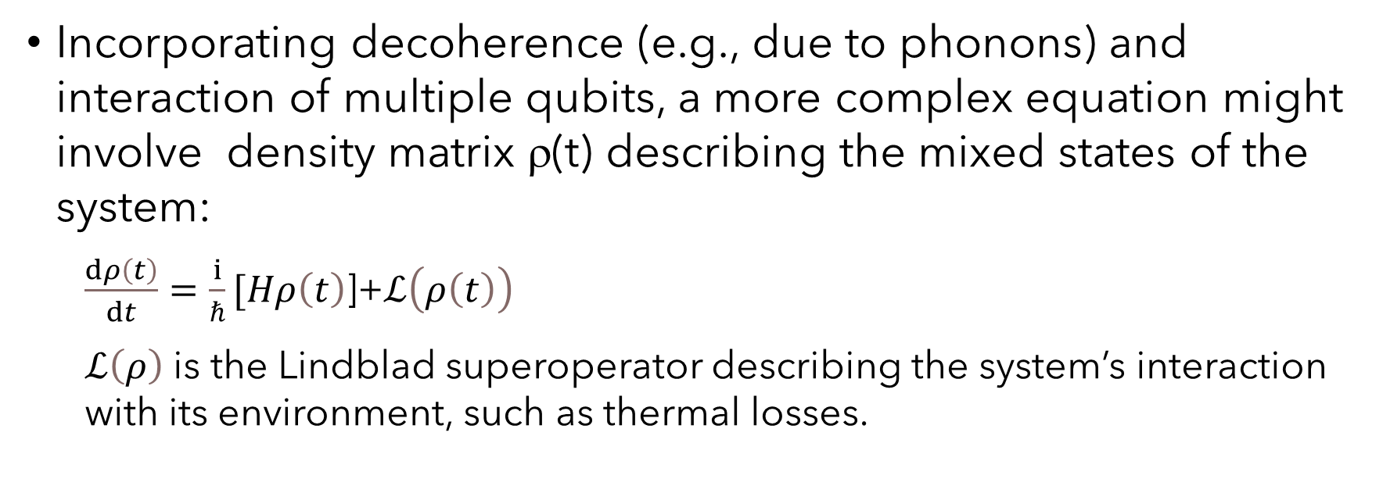
Full state equation
Incorporating decoherence (e.g., due to phonons) and interaction of multiple qubits, a more complex equation might involve density matrix ρ(t) describing the mixed states of the system:
  $\frac{ⅆρ\left(t\right)}{ⅆt}=\frac{ⅈ}{ℏ}[Hρ\left(t\right)$]+$ℒ\left(ρ\left(t\right)\right)$
  $ℒ\left(ρ\right)$ is the Lindblad superoperator describing the system’s interaction with its environment, such as thermal losses.

Slide 12
Measurement of polariton
Dielectric properties change:
  Permittivity
  Reflection
  Polarizability

Slide 13
1 and 0 (reflection)

Slide 14
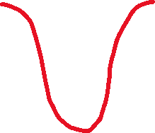



Polariqon Operation
Detection of I1> and I0>
Before…
…After
Conduction Band
I1>
Valence Band
I0>
I0>
.. affecting the shape of the bands
K
K

Slide 15
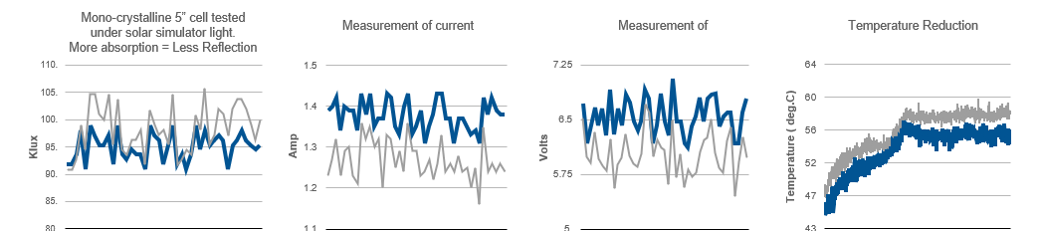
Solar Cell as detector
Detection- Current, Voltage and Temperature

Slide 16
Quantum computing with polaritons
  Due to their photonic nature, they interact and process quantum information at very high speeds compared to purely matter-based quantum systems.
  Polaritons, especially in standing wave, can maintain quantum coherence for a relatively long time
  Gates: Could use polariton-polariton interaction, in addition to electric and magnetic switching
  Reduced Errors: Polariton can exist in surface states (or any engineered location) allowing them to be less prone to perturbing forces
  Reduced power: No cryogenics needed

Slide 17
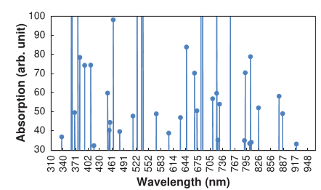
Entanglement (spontaneous parametric Down conversion)
Figure demonstrates the generation of additional absorption peaks when detector solar cell is subjected to the pulses.
The appearance of additional absorption peaks in the spectroscopic analysis clearly demonstrates creation of new energy states upon application of the pulses.

Slide 18
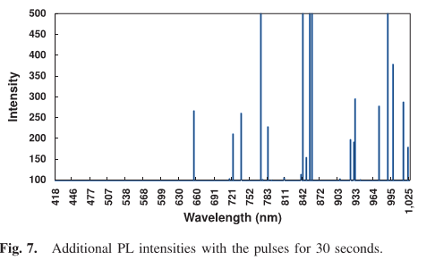

spontaneous parametric Down conversion-spdc
Interaction of electromagnetic wave with multistate atoms can also be treated as Jaynes-Cumming Interaction (quantized electromagnetic wave interacting with a multi-state atom) integrated over the lattice. The Jaynes-Cummings Hamiltonian is given by
ω represents the frequency of the photon and ω₀ is the resonance frequency. The Hamiltonian is for creating an excited state by absorbing a photon and de-exciting a stateby creating a photon.
Using the electric ﬁeld oscillation of the pulses to replace the electric ﬁeld of the photon creation of new excited states can be predicted and calculated using Jaynes-Cummings Hamiltonian

Slide 19
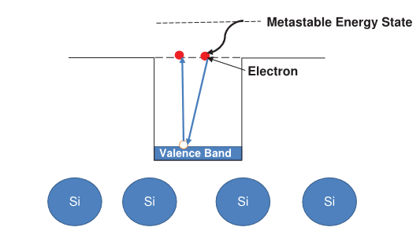
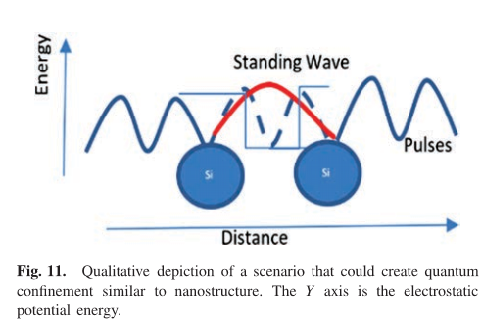
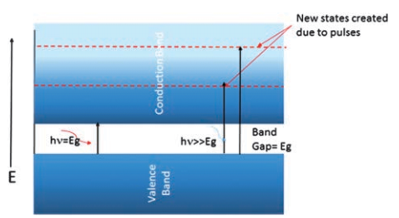
SPDC
Generation of multi-exciton in our experiments is from the photo luminescence measurements. It can be observed from comparison of the absorption peaks that the wavelengths of absorption peaks approximately correspond to half the wavelength of the PL peaks, suggesting that the energies of the photons

Slide 20
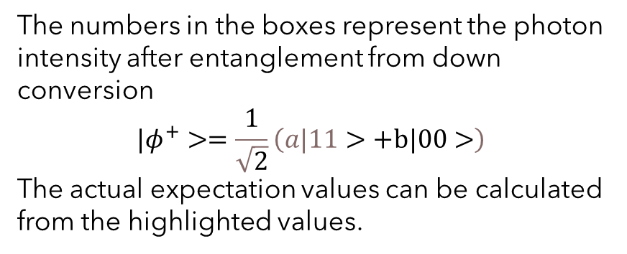
SPDC Data
Wavelength | 2X | 1X diff | Entangled | SQRT
292.648 | 585.296 | 9.49 | 131.2 | 11.45426
296.275 | 592.55 | 9.49 | 245.88 | 15.68056
300.805 | 601.61 | 9.49 | 318.44 | 17.84489
316.623 | 633.246 | -18.6 | 236.52 | 15.37921
334.633 | 669.266 | 16.52 | 124.18 | 11.14361
Wavelength | 2X | 1XDiif | Entangled | SQRT
289.926 | 579.852 | 66.57 | 237.44 | 15.40909
293.555 | 587.11 | 8.07 | 298.28 | 17.27078
297.635 | 595.27 | -17.69 | 368.5 | 19.19635
334.184 | 668.368 | -10.66 | 279.56 | 16.72005
375.33 | 750.66 | -13 | 244.46 | 15.63522
t=0
Wavelength | 2X | 1Xdiff | Entangled | SQRT
289.473 | 578.946 | -29.25 | 705.67 | 26.56445
293.555 | 587.11 | -1.17 | 403.75 | 20.09353
339.125 | 678.25 | -45.64 | 305.44 | 17.47684
t=1 sec
The numbers in the boxes represent the photon intensity after entanglement from down conversion
$$|φ^{+}>=\frac{1}{\sqrt{2}}\left(a|11>+b|00>\right)$$
The actual expectation values can be calculated from the highlighted values.
Wavelength | 2X | 1XDiif | Entangled | SQRT
289.019 | 578.038 | -61.5 | 9382.43 | 96.86294
290.38 | 580.76 | -56.82 | 8982.2 | 94.77447
292.195 | 584.39 | -49.8 | 9106.24 | 95.42662
292.648 | 585.296 | -47.46 | 9014.96 | 94.94714

Slide 21


Encoding- using electric field
Photon Intensity (Klux) | After electric field programming
1660 | 1615
1657 | 1614
1655 | 1618
$$\frac{1}{\sqrt{2}}\left(a|1>+b|0>\right)$$
$$\frac{1}{\sqrt{2}}\left(a|1>\right)$$

Slide 22
System architecture
F
I
LTER
Electric Field Gate
Coherent
Polariton Generation
Spectroscopic Detection
X
Programming Layer
X
Photoelectric detection
Photoelectric Current
Hall Gate

Slide 23
Reading polariton qubits
Reading the state of polaritonic qubits, or qubits based on polaritons, is complex but feasible by leveraging the properties of light-matter interactions. Here’s a general overview of how it’s approached:
  Optical Measurement: Polaritons are hybrid quasiparticles formed by coupling photons with excitons (electron-hole pairs). Because they involve photons, the state of polaritonic qubits can be read optically, usually by detecting the emitted light. This optical signal carries information about the quantum state of the polariton.

Slide 24
Reading polariton qubits
Phase and Intensity Measurements:
  Information about the phase and amplitude of the emitted light can reveal the state of the polaritonic qubit. Techniques such as interferometry may be used to measure phase differences, which are crucial for distinguishing qubit states.
Polarization: Polariton states can be manipulated and read using the polarization of light, as different polarization states may correspond to different qubit states.
  Circular or linear polarizations can encode different logical states (|0⟩ and |1⟩)

Slide 25
Reading polariton qubits
Resonant and Non-resonant Excitation: To read qubit states without significantly disturbing them, resonant excitation methods can probe specific polariton energy levels associated with the qubit states.
Non-resonant methods, meanwhile, can help in detecting relaxation dynamics and population differences.
Spectroscopy: Techniques like photoluminescence spectroscopy can analyze the spectrum of emitted light from the polariton system, providing insight into the energy states. This spectral information helps determine the qubit’s superposition or mixed state.

Slide 26
Reading polariton qubits
The field of polaritonic qubits is relatively new, and advancements are ongoing. The primary challenge in reading polaritonic qubits lies in minimizing measurement-induced disturbance while accurately retrieving state information, which is critical for preserving coherence and fidelity in quantum computation.

Slide 27
Deciphering qubit state from photo-luminescence
Determining the qubit state from the intensity of the emitted photoluminescence involves analyzing the relationship between the photoluminescence signal and the occupation or population of the polariton states associated with the qubit’s logical states, often labeled |0⟩ and |1⟩.
Here’s how this process typically works:
  Establishing the Qubit Basis: In a polaritonic qubit, the states |0⟩ and |1⟩ might correspond to different energy levels or configurations of the polariton system. For example, one state could represent a lower energy level (ground state or lower polariton) while the other represents a higher energy level (excited state or upper polariton).

Slide 28
Deciphering qubit state from photo-luminescence
Intensity as an Indicator of Occupation:
  The intensity of photoluminescence at specific energies or wavelengths can be correlated with the population of these states. When the polaritonic qubit is in the |1⟩ state (higher-energy polariton), it may emit photoluminescence with higher intensity at a particular wavelength corresponding to that energy level.
  If it’s in the |0⟩ state (lower-energy polariton), the intensity may be lower or at a different wavelength.

Slide 29
Deciphering qubit state from photo-luminescence
Spectral Filtering:
  By using spectral filters or monochromators, it’s possible to isolate the photoluminescence emitted by each specific state.
  Measuring the intensity at these filtered wavelengths helps identify which qubit state (|0⟩ or |1⟩) is occupied based on how much light is emitted.
Calibration:
  Establish a baseline by measuring the photoluminescence intensities when the qubit is intentionally prepared in a known |0⟩ state and then in a known |1⟩ state.
  It provides reference intensity levels for interpreting intermediate or unknown states.

Slide 30
Deciphering qubit state from photo-luminescence
Superposition States:
For a polaritonic qubit in a superposition (e.g., a mixture of |0⟩ and |1⟩), the intensity may be a weighted average of the intensities associated with |0⟩ and |1⟩.
In such cases, the measured intensity can indicate the probability distribution between the states but may require more sophisticated analysis, potentially with phase-sensitive detection.

Slide 31
Deciphering qubit state from photo-luminescence
Decay Dynamics:
  Polariton lifetimes are generally short, so the decay rate of the photoluminescence can also carry information about the qubit’s state.
  Measuring the intensity as a function of time can offer clues about the energy levels and occupation states of the polaritons, helping further distinguish |0⟩ and |1⟩.
  Through these techniques, researchers can deduce the qubit state from the photoluminescence intensity.
    However, the process requires precision to distinguish between states accurately without perturbing the quantum system more than necessary.

Slide 32
Building gates
Light-matter interactions and nonlinearities of polaritons to perform controlled quantum operations.
Rabi Oscillations for Single-Qubit Gates
  Mechanism: Rabi oscillations are induced by applying an external laser field that couples two polariton states (e.g., |0⟩ and |1⟩) at a specific resonant frequency. By controlling the pulse duration and amplitude, one can control the rotation angle on the Bloch sphere, enabling gates like the Pauli-X, Y, and Z gates (corresponding to bit-flip and phase-shift operations) and arbitrary rotations.
  Applications: Single-qubit gates, such as the Hadamard (H), Pauli (X, Y, Z), and arbitrary rotations (Rx, Ry, Rz), can be constructed by carefully tuning these oscillations to achieve desired rotations.

Slide 33
Building Gates- 2 qubits
Two-Qubit Gates via Polaritonic Interactions
  Mechanism: Polaritons are known for strong nonlinear interactions when in close proximity, especially within microcavity systems or semiconductor structures.
  Two polaritonic qubits can interact through their overlap or proximity within a shared cavity, enabling entangling gates like the Controlled-NOT (CNOT) or Controlled-Z (CZ) gate.
  Method: By spatially confining two polaritons and tuning an external laser, one can control the interaction strength, which allows the implementation of a controlled-phase gate. This phase shift becomes the basis for entangling operations.
  Example: In a cavity, if one qubit’s state depends on the other (via their mutual influence on resonance frequencies), this dependency can enact a CNOT gate, with one polariton’s state flipping based on the state of the other.

Slide 34
Building gates- spin selective excitation
Spin-Selective Excitation and Polarization Control
  Mechanism: Polaritonic qubits can also be defined based on the polarization state (e.g., circular or linear polarization). By controlling the polarization of an external laser, you can selectively excite specific qubit states or induce phase changes.
  Applications: A spin-polarized laser can selectively manipulate qubit states based on polarization, enabling phase gates or selective rotations necessary for universal quantum computing

Slide 35
Building gates
Using Exciton-Polaritons for Nonlinear Phase Shifts
  Mechanism: Exciton-polaritons, which are polaritons coupled to excitons, exhibit significant nonlinearities. These nonlinear interactions allow for phase shifts that depend on the number of polaritons in a mode, enabling quantum gates based on conditional phase shifts.
  Example: A Kerr-type interaction between exciton-polaritons in a microcavity can lead to a conditional phase shift, which is key to implementing gates like CZ, where the phase of one qubit depends on the state of another.

Slide 36
Building gates
Cavity-QED Techniques for Polariton Coupling
  Mechanism: Coupling polaritons with high-quality cavities enhances light-matter interaction, enabling fine control over polariton states and their interactions. By embedding polaritons in coupled cavity arrays or photonic lattices, it’s possible to manipulate qubit states in a controlled way for entangling gates.
  Applications: Cavity-QED setups can facilitate gates like the SWAP or controlled rotations by controlling interactions in the spatial or frequency domain within the cavities.

Slide 37
Building gates
Topological Protection for Robust Gates
Mechanism: In recent research, polaritonic systems in certain lattice configurations (such as honeycomb or Lieb lattices) have shown topologically protected states. Using these configurations, one can create robust qubit gates that are less sensitive to environmental noise
Application: Topologically protected modes could support robust single- and two-qubit gates, especially for error-resistant quantum operations.

Slide 38
Building gates
Challenges and Current Research
  While the mechanisms above are promising, polaritonic quantum gates are an emerging field. Main challenges include:
  Coherence Time: Polaritons have short lifetimes due to photon escape from cavities, so maintaining coherence is an ongoing challenge.
  Precision Control: Fine control over interactions requires precise laser tuning and advanced cavity engineering.
  Scalability: Scaling up to multiple qubits requires designing systems where many polaritons can interact without loss of coherence.
Despite these challenges, the unique properties of polaritons—especially their nonlinear interactions and strong coupling to light—make them a compelling platform for implementing quantum gates, especially for systems that leverage hybrid light-matter properties.

Slide 39
THANK YOU
Santosh Kumar

